Slide 1

Social Care Nurse ADVISORY COUNCIL SOUTH EAST

Slide 2
Aims of the council
A Nursing forum for the voice of social care nurses
ADVOCACY for social care nursing
Better integration with social care and the icb
Working towards solutions and sharing best practice

Slide 3
Why are they important?
“Social care nursing is an important part of the health and care system. The reforming of the Social Care Nurse Advisory Councils ( SCNAC’s) into 7 regional councils will ensure a stronger collaboration between other sector colleagues from workforce, research and HEI’s and facilitate a greater number of voices to influence and shape work with NHSE ICB Nurse colleagues and their teams. These forums will act as touchstones for every ICB (Integrated Care Board) nurse, making sure social care nursing and the wider workforce are included in the development of nursing plans across all health and care settings. These peer advisory groups bring a wealth of experience, insight and expertise to the table, better informing the development of nursing practice, system-wide. I hope colleagues will come forward and be part of that critical social care nursing specialist voice.”
DEBORAH STURDY

Slide 4
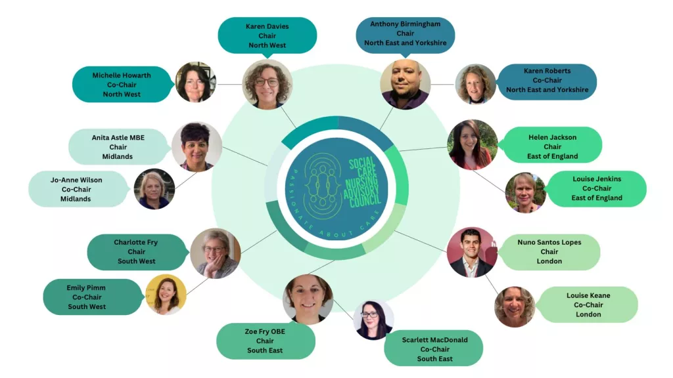

Slide 5



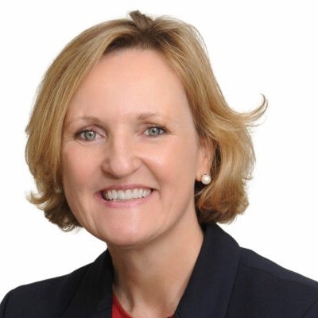
https://theoutstandingsociety.co.uk/case-study/scnac/
Admin.SCNAC@theoutstandingsociety.co.uk

Slide 6
How to find out more and get involved scnac - The Outstanding Society
admin.scnac@theoutstandingsociety.co.uk

